Slide 1


“A chopped head is cheaper than a felled tree.”
- Amrita Devi

Slide 2
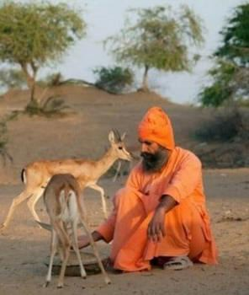
The Bishnoi faith is a religious offshoot of Hinduism founded on 29 principles, most of which promote environmental stewardship.
The religion was founded by Guru Maharaj Jambaji in 1485 AD in the Marwar (Jodhpur) desert region of western Rajasthan, India.
He banned cutting down green trees and killing birds or animals.
Bishnois are famous for cultivating lush vegetation, caring for animals, and collecting drinkable water.

Slide 3
Principles of Bishnoi philosophy relevant to
environmental protection
To be compassionate towards all living beings.
Do not cut the green trees, save the environment.
To provide a common shelter for goat/sheep to avoid
them being slaughtered.
Don’t sterilize bulls.
Feed and protect wildlife.

Slide 4
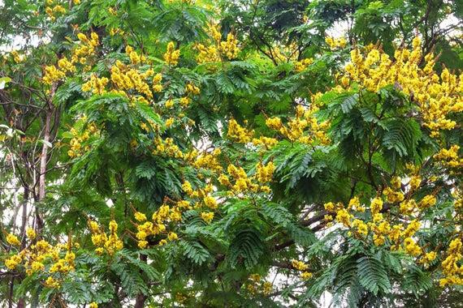
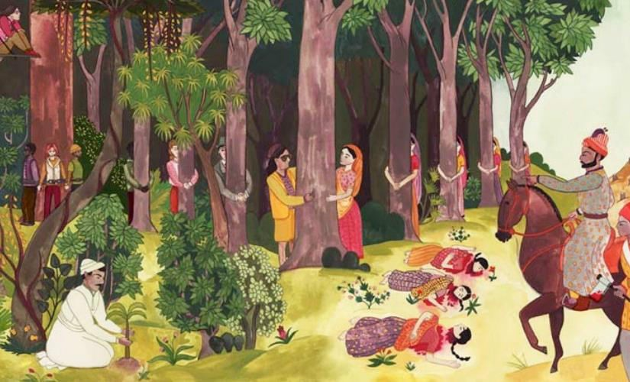
In 1730, maharajah (king) of Jodhpur sent soldiers to gather khejri
(acacia) wood from the forest region near the village of Khejarli.
Amrita Devi was a female villager who decided to literally hug the trees, and encouraged others to do so too.
As each villager hugged a tree, refusing to let go, they were beheaded by the soldiers.
This voluntary martyrdom continued until 363 Bishnoi villagers were killed in the name of the sacred Khejarli forest.

Slide 5


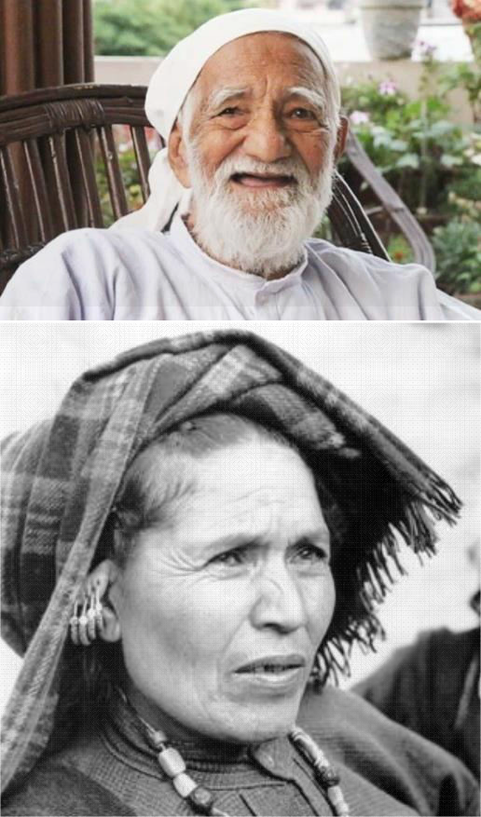
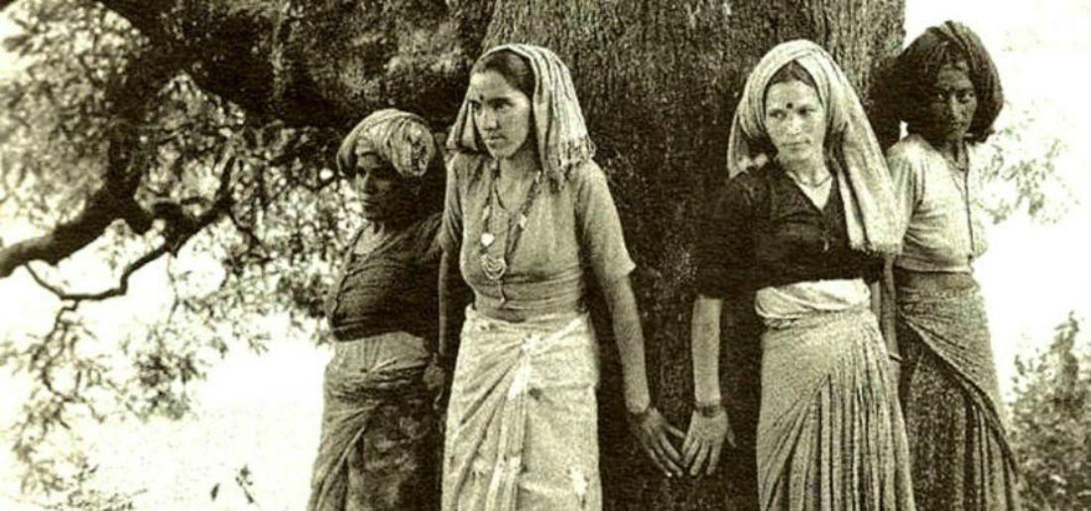
Chipko movement (Chipko andolan): A nonviolent social and ecological movement by rural villagers in India in the 1973, aimed at protecting trees and forests slated for government-backed logging.
The movement originated in the Himalayan region of Uttar Pradesh (now Uttarakhand).
Inspired by Bishnoi movement
The main objective was to protect the trees on the Himalayan slopes from the axes of contractors of the forest.
Led by Sundarlal Bahuguna, Gaura Devi, Sudesha Devi

Slide 6

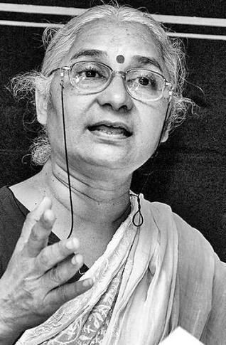
The movement first started in 1985 as a protest for not providing proper rehabilitation and resettlement for the people who have been displaced by the construction of Sardar Sarovar Dam.
Later on, the movement turned its focus on the preservation of the environment and the eco-systems of the valley.
Led by Medha Patekar

Slide 7
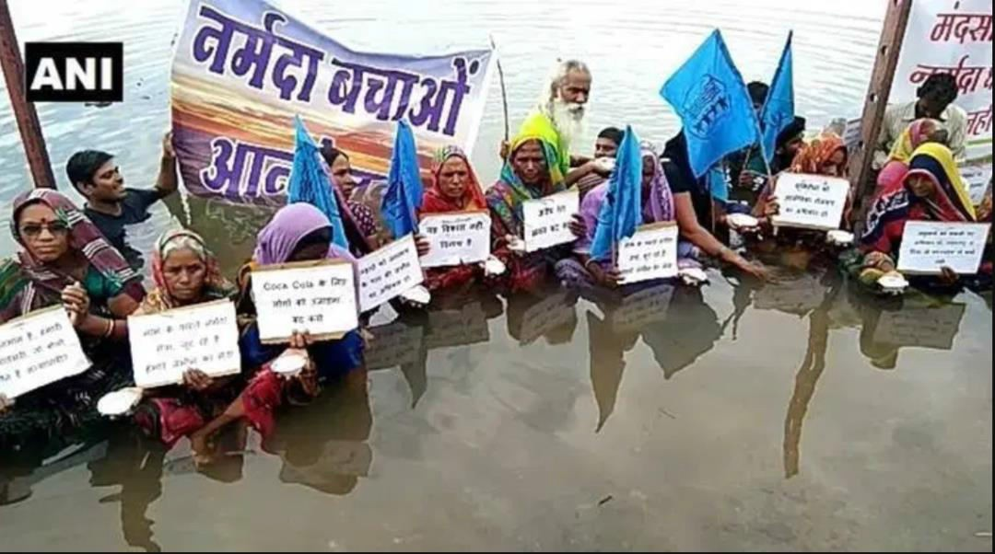
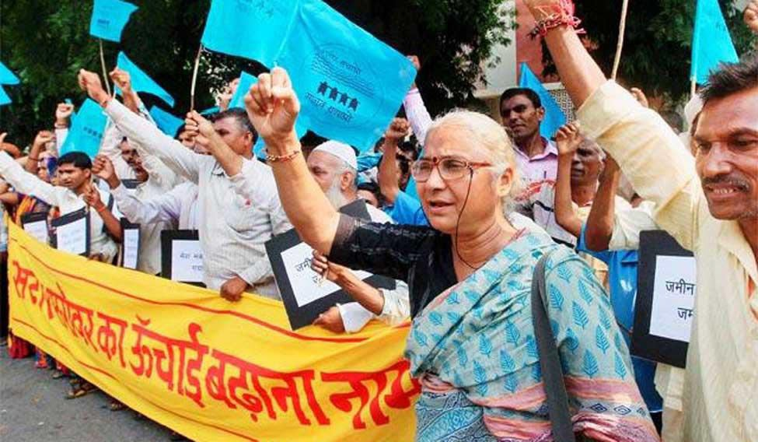
Activists also demanded the height of the dam to be reduced to 88 m from the proposed height of 130m. World Bank withdrew from the project.
In October 2000, the Supreme Court gave a judgment approving the construction of the Sardar Sarovar Dam with a condition that height of the dam could be raised to 90 m.
The project is expected to be fully completed by 2025.

Slide 8
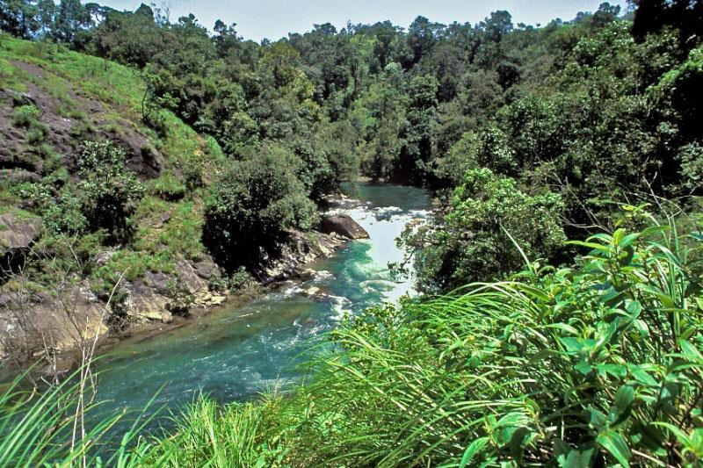
The Silent Valley is one of the last undisturbed rain forests and tropical moist evergreen forests in India.
It is located in the Nilgiri Hills, Palakkad District in Kerala, South India.
16 bird species and 34 species of mammals in Silent Valley are threatened.
Over 128 species of
butterflies and 400 species of moths live here.

Slide 9
The Kerala State Electricity Board (KSEB) proposed a hydroelectric dam across the Kunthipuzha River that runs through Silent Valley.
In February 1973, the Planning Commission approved the project.
Several NGOs strongly opposed the project and urged the
government to abandon it.
In January 1981, Indira Gandhi declared that Silent Valley will be protected.
In November 1983 the Silent Valley Hydroelectric Project
was called off.
In 1985, Prime Minister Rajiv Gandhi formally inaugurated the Silent Valley National Park.

Slide 10

Switch off lights, fans and other appliances when not in
use.
Use solar heater for cooking your food on sunny days.
Use minimum amount of water for all domestic purposes.
Built rainwater harvesting system in your house.
Grow different types of plants, herbs, trees and grass in your garden and open areas.
Don’t use more fertilizer and pesticides. Use nature manure to the crops.
Don’t waste the food instead give it to someone before getting spoiled.

